Slide 1
Variational Inference in Bayesian Submodular Models
Josip Djolonga joint work with Andreas Krause

Slide 2
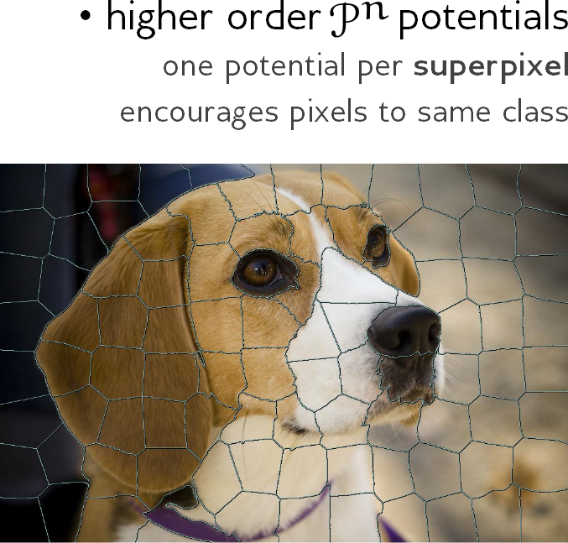
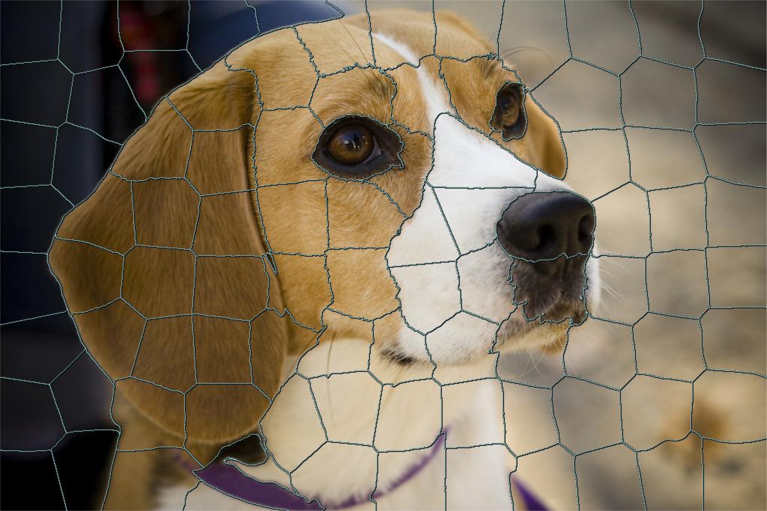
Motivation inference with higher order potentials
MAP Computation ✓
Inference? ✘
We provide a method for inference in such models
… as long as the factors are submodular

Slide 3
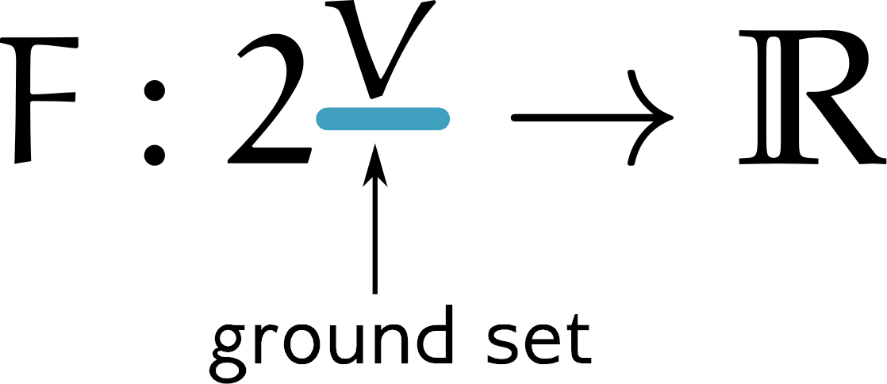
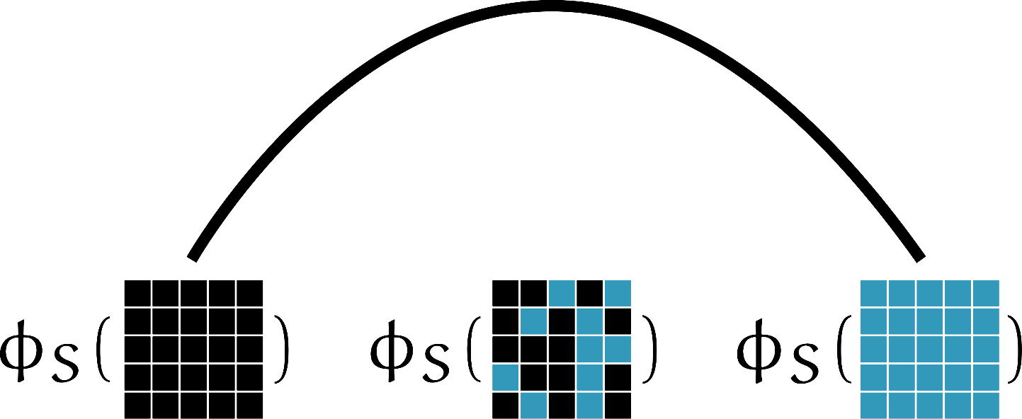
Submodular functions
Set functions that have the diminishing returns property
Many applications in machine learning
sensor placement, summarization, structured norms, dictionary learning etc.
Important implications for optimization

Slide 4
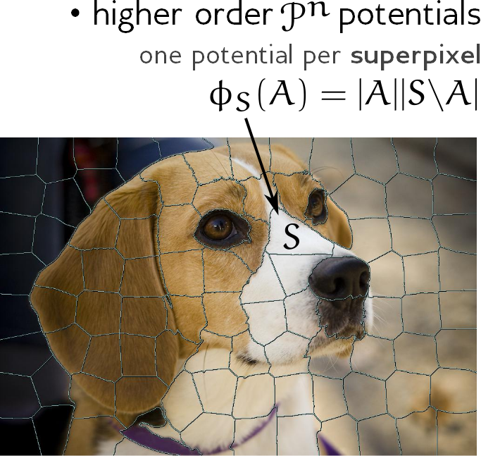
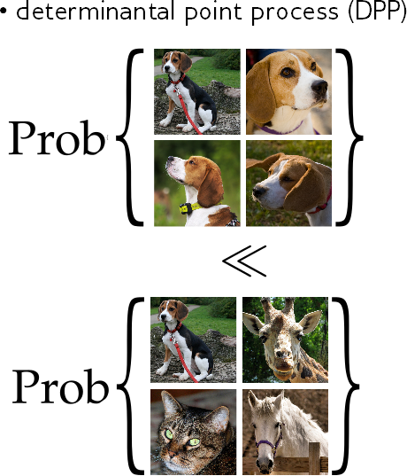
From optimization to distributions
Instead of optimization, we take a Bayesian approach
Log-supermodular Log-submodular
Equivalent to distributions over binary vectors
Conjugacy, closed under conditioning

Slide 5
Our workhorse: modular functions
Additive submodular functions, defined as
They have completely factorized distributions, with marginals

Slide 6
Remark on variational approximations
Most useful when conditioning on data
posterior
prior
x
likelihood

Slide 7
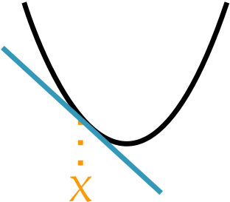
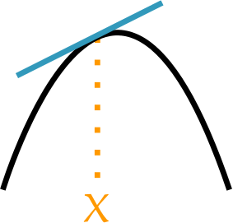
Sub- and superdifferentials
As convex functions, submodular functions have subdifferentials
But they also have superdifferentials

Slide 8
The idea
Using elements from the sub/superdifferentials we can bound F
Which in turn yields bounds on the partition function
We optimize over these upper and lower bounds
Intervals for marginals, model evidence etc.

Slide 9
Optimize over subgradients
The problem provably reduces to [D., Krause ’14]
Equivalent to min-norm problem [D., Krause ’15, c.f. Nagano ‘07]
Corollary: Thesholding the solution at ½ gives you a MAP configuration.
(i.e., approximation shares mode).

Slide 10
Min-norm problem in a more familiar (proximal) form
Cut on a chain
Cuts in general

Slide 11
Connection to mean-field
The mean field variational problem is
In contrast, the Fenchel dual of our variational problem is
Multilinear extension
Expensive to evaluate, non-convex
Lovász extension / Choquet integral

Slide 12
Divergence minimization
Theorem: We optimize over all factorized distributions the Rényi divergence of infinite order
P
Q
Approximating distribution is „inclusive“

Slide 13
The big picture how they all relate
Divergence minimization qualitative results
Dual: Lovász – Entropy
Minimize bound on Z
Convex minimization on B(F)
Min-norm point fast algorithms
≡
≡
≡
≡

Slide 14
Message passing for decomposable functions
Sometimes, the functions have some structure so that

Slide 15
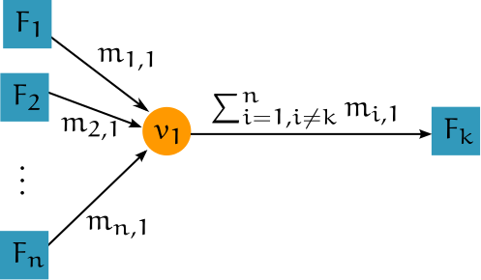
Message passing the messages

Slide 16
Message-passing convergence guarantees [based on Nishishara et al.]
Equivalent to doing block coordinate descent
One can also easily compute duality gaps at every iteration

Slide 17
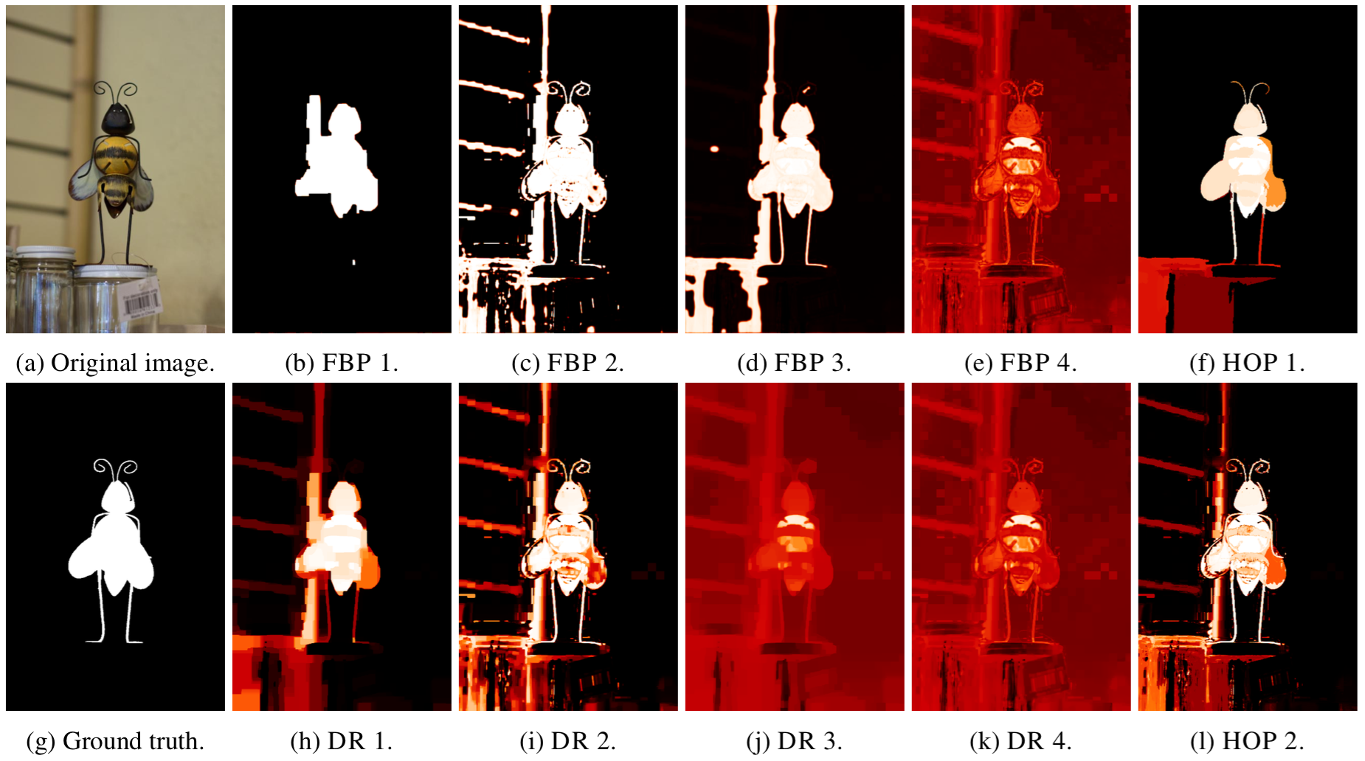
Qualitative results (data from Jegelka et al.)
Pairwise only (strong ↔ weak prior)

Slide 18
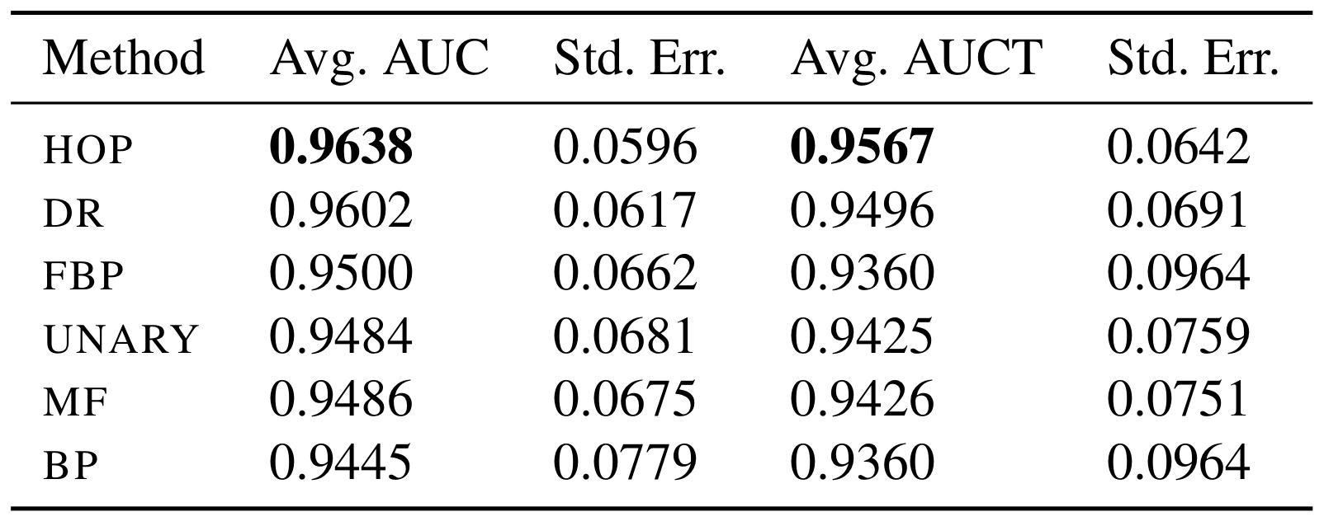
Experimental results over 36 finely labelled images (from Jegelka et al.)
Higher-order
Pairwise only
Full image
Near boundary

Slide 19
Message passing example (427x640 with 20,950 factors, approx. 1.5s / iter)

Slide 20
Summary
Algorithms for variational inference in submodular models
Both lower and upper bounds on the partition function
But also completely factorized approximate distributions
Convergent message passing for models with structure

Slide 21
Thanks!
Python code at http://people.inf.ethz.ch/josipd/

