Slide 1
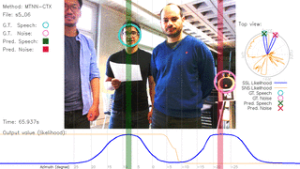
Joint Localization and Classification of Multiple Sound Sources Using a Multi-task Neural Network
Weipeng He, Petr Motlicek and Jean-Marc Odobez
Idiap Research Institute École Polytechnique Fédérale de Lausanne

Slide 2
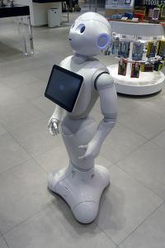
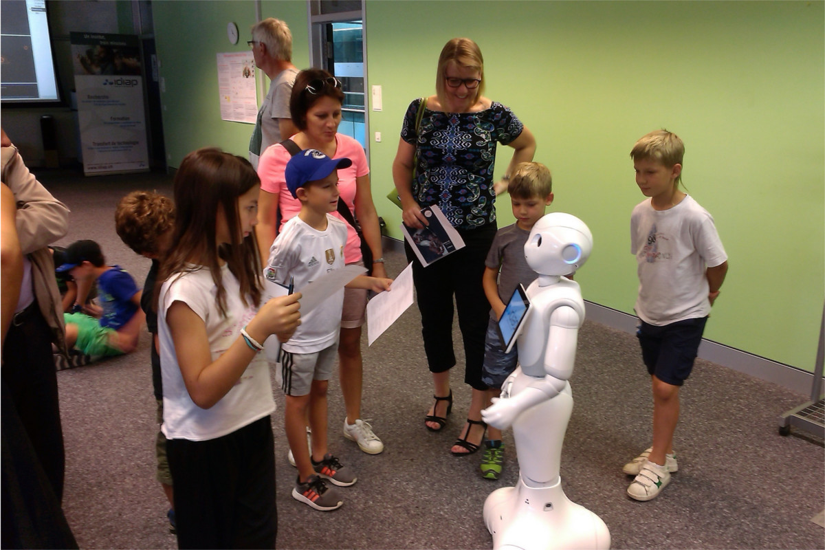
Research Background: MuMMER Project
Goal: Robot in a shopping mall

Slide 3
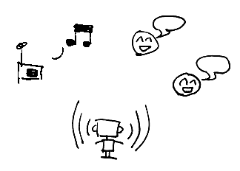
Problems: Localization and Classification
Wild Environment:
Robot ego noise
Simultaneous sound sources
Speech and non-speech sources
Localize sound sources and classify them into speech or non-speech sources.

Slide 4
Previous Studies
Problems are solved sequentially:
Localization
Beamformer/ Separation
Classification
Examples:
May et al. “A Binaural Scene Analyzer for Joint Localization and Recognition of Speakers in the Presence of Interfering Noise Sources and Reverberation,” 2012.
Crocco et al. “Audio Tracking in Noisy Environments by Acoustic Map and Spectral Signature,” 2017.
Notes:
citation

Slide 5
Contribution: Jointly Solving Both Problems
Sound localization and classification can help each other:
We propose:
Jointly solving both problems
Multi-task neural network
Localization
Spatial information
Classification
Spectral information

Slide 6
Overview
SSL : sound source localization
SNS : speech/non-speech

Slide 7
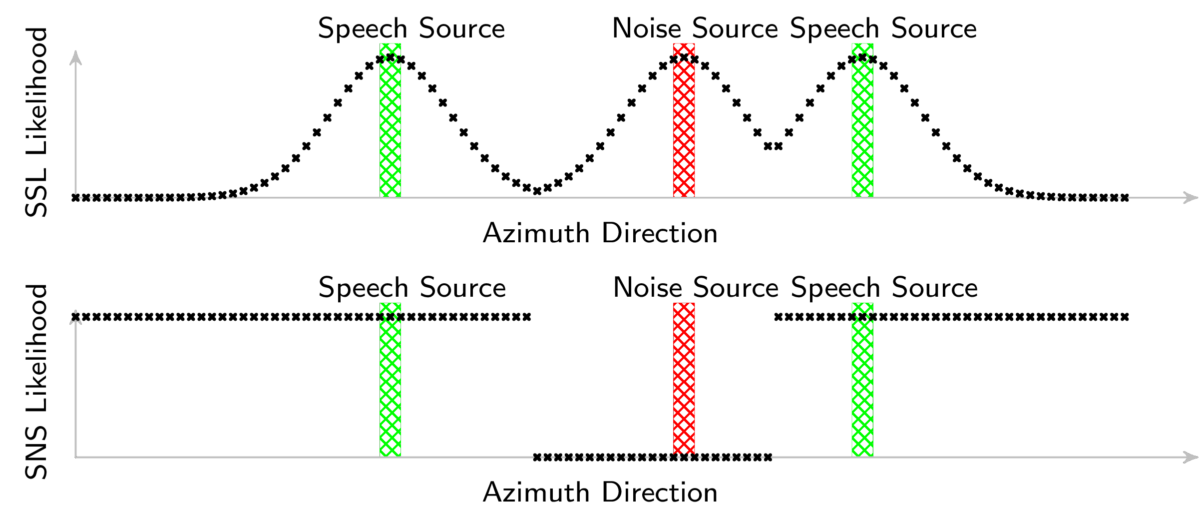
Output and Loss Function
Likelihood score on each direction
$$p:$$
$$q:$$
$$Loss= {\left\|\hat{p}−p\right\|}_{2}^{2}+\sum_{i}{w_{i}{\left|{\hat{q}}_{i}−q_{i}\right|}^{2}}$$
emphasis on directions next to active sources
$$w:$$
Notes:
P and Q

Slide 8
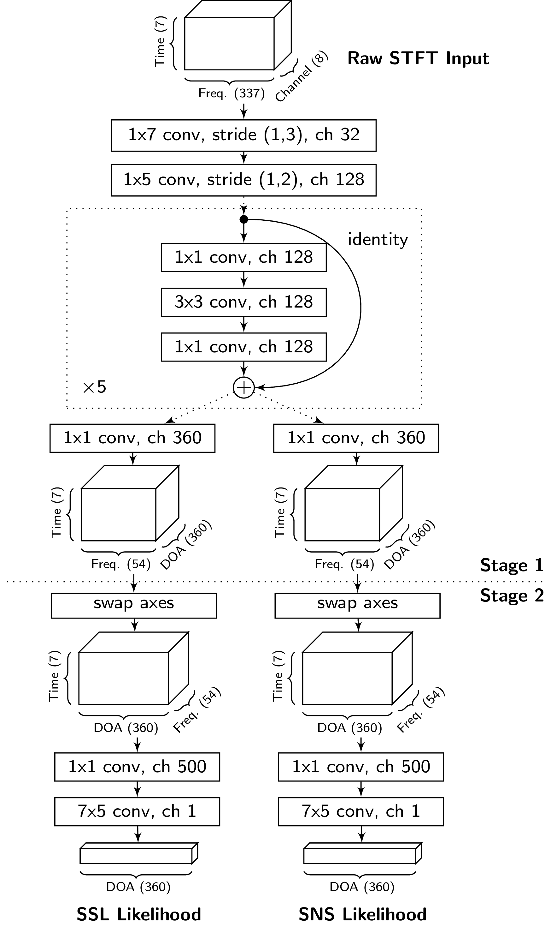
Network Structure
Fully Convolutional:

Slide 9
Network Structure
Fully Convolutional:
Residual network trunk
Notes:
T-f filtering

Slide 10
Network Structure
Fully Convolutional:
Residual network trunk
Two task-specific branches

Slide 11
Two-Stage Training
Train whole network end-to-end

Slide 12
Two-Stage Training
Stage 1:
Convolution in time-frequency (TF) domain: the output is TF-local.
Notes:
Indicate in the axes

Slide 13
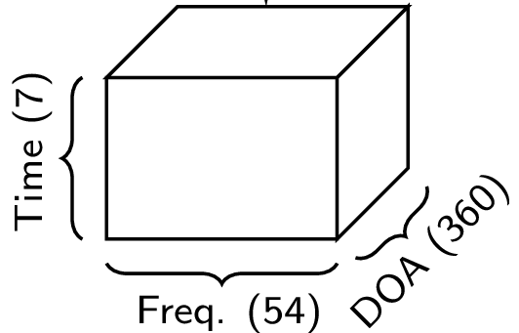
Two-Stage Training
Stage 1:
Convolution in time-frequency (TF) domain: the output is TF-local.
Output 360 channels: can be interpreted as early prediction for each TF point.
Notes:
Indicate in the axes

Slide 14
Two-Stage Training
(1) Supervision on output of Stage 1
(2) Train whole network end-to-end

Slide 15
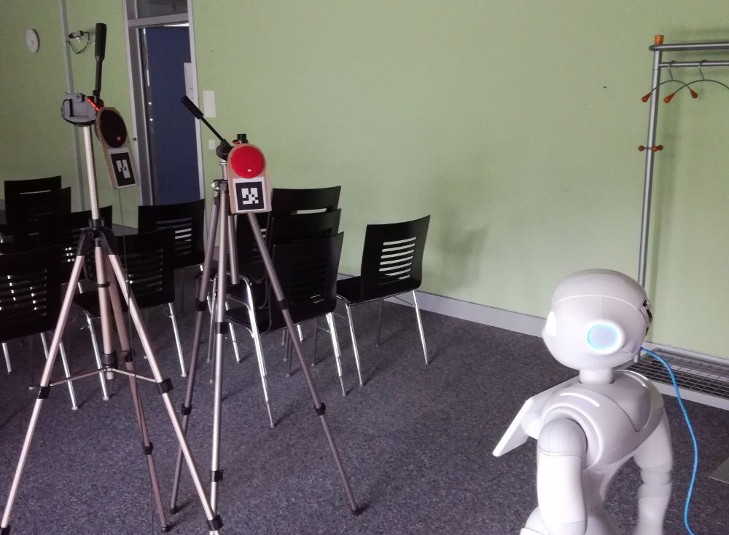
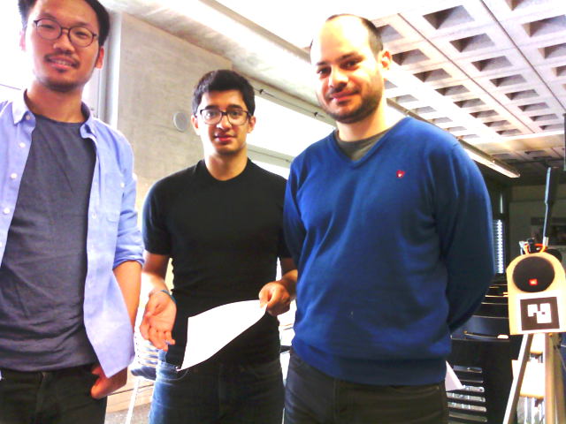
Data
Training:
Loudspeakers: 32 hours, 148 speakers
Speech: AMI Corpus
Non-speech: Google AudioSet
Test:
Loudspeaker: 17 hours, 16 speakers
Human talkers: 8 minutes, 7 speakers
AMI Corpus: http://groups.inf.ed.ac.uk/ami/corpus/
AudioSet: https://research.google.com/audioset/
Notes:
url

Slide 16
Result 1: Loudspeaker Rec.
Notes:
Mention pepper camera

Slide 17
Result 2: Human Rec.
Notes:
Mention pepper camera

Slide 18
Result 3: Human Rec.
Notes:
Mention pepper camera

Slide 19
Evaluation
Sound Localization
Speech/Non-speech Classification
Speech Localization
Methods
Baseline: Localization + MVDR + Classification
Proposed method

Slide 20
Result: Sound Localization Human Recordings
Proposed Method >90% precision >80% recall
(Similar conclusion can be drawn for loudspeaker recordings)

Slide 21
Result: Speech/Non-speech Classification
(Assuming sound direction is known)
Accuracy | Loudspeaker | Human
Baseline | 0.80 | 0.68
Proposed Method | 0.95 | 0.85

Slide 22
Result: Speech Localization Human Recordings
Proposed Method >80% precision >70% recall
(Similar conclusion can be drawn for loudspeaker recordings)
Notes:
Display observation in bullet points

Slide 23
Result: Speech Localization Human Recordings
Without 2-stage Training
(Similar conclusion can be drawn for loudspeaker recordings)
Notes:
Display observation in bullet points

Slide 24
Result: Speech Localization Human Recordings
Extension:
Add Temporal Context to Input
(600ms instead of 170ms)
(Similar conclusion can be drawn for loudspeaker recordings)
Notes:
Display observation in bullet points

Slide 25
Conclusion
We proposed deep learning-based methods for jointly solving sound localization and classification:
Implemented for a real robot.
Significant better performance compared to baseline in speech/non-speech classification and speech localization.
Two-stage training allows better model to be trained.
Further improvement by adding temporal context.
Notes:
implemented in robots

Slide 26
Thank you!

Slide 27
Result: Sound Localization Loudspeaker Recordings
Proposed Method >90% precision >80% recall

Slide 28
Result: Sound Localization Human Recordings
Proposed Method >90% precision >80% recall
(Similar conclusion can be drawn for loudspeaker recordings)

Slide 29
Result: Speech/Non-speech Classification
(Assuming sound direction is known)
Accuracy | Loudspeaker | Human
Baseline | 0.80 | 0.68
Without 2-Stage | 0.93 | 0.82
Proposed Method | 0.95 | 0.85
Adding Context | 0.96 | 0.89

Slide 30
Result: Speech Localization Loudspeaker Recordings
Proposed Method ~90% precision ~80% recall

Slide 31
Result: Speech Localization Human Recordings
Proposed Method >80% precision >70% recall
(Similar conclusion can be drawn for loudspeaker recordings)
Notes:
Display observation in bullet points

Slide 32
Loss Function
$$Loss= {\left\|\hat{p}−p\right\|}_{2}^{2}+\sum_{i}{w_{i}{\left|{\hat{q}}_{i}−q_{i}\right|}^{2}}$$
Predicted SSL Likelihood
Predicted SNS Likelihood
Ground truth SSL Likelihood
Ground truth SNS Likelihood
Notes:
Merge with previous slide

Slide 33
Loss Function
$$Loss= {\left\|\hat{p}−p\right\|}_{2}^{2}+\sum_{i}{w_{i}{\left|{\hat{q}}_{i}−q_{i}\right|}^{2}}$$
Weighted with the emphasis on directions next to active sources

Slide 34
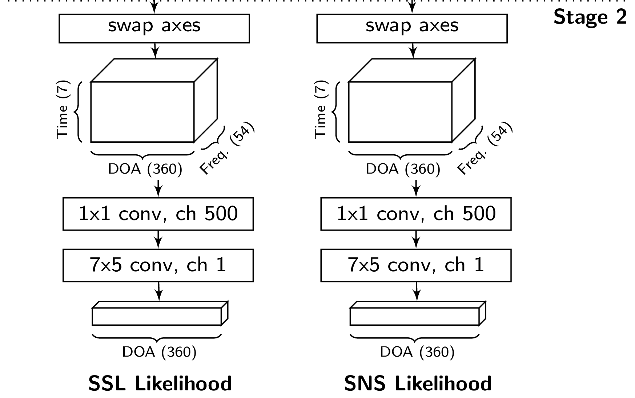
Network Structure
Stage 2:
Aggregates predictions from all TF points.

